Slide 1


Hong Kong’s Linked Exchange Rate System (LERS)
Aug 2022
Stephen Fok, Jocelyn, Terence

Slide 2
Background and Objective
When USD/HKD hits below 7.75:
- Funds flowing into HKD (the demand of HKD is high)
- HKD interest rate higher than USD
- IPO in HK
- HKMA will sell HKD at HK$7.75/US$1 to the bank
- The aggregate balance will rise
- Interest Rate (HIBOR) will decline
When USD/HKD hits above 7.85:
- Funds flowing out of HKD (the demand of USD is high)
- USD interest rate higher than HKD
- HKMA will buy HKD at HK$7.85/US$1 from the bank
- The aggregate balance will drop
- Interest rate (HIBOR) will rise
The aim of this project is to analyze the mechanism of Hong Kong’s Linked Exchange System (LERS)

Slide 3
Project Planning
01
02
Brainstorming
03
Data Preprocessing
Data Collection
Research
Open API – HKMA website
What kind of data do we need to perform the analysis?
Which websites provide the necessary data?
Which method is appropriate to extract the data?
HIBOR Rate (Hong Kong Interbank Offered Rate)
HKMA aggregate balance
USD/HKD exchange rate movement against non peg currency
04
Analysis
Data cleaning and transformation
Data visualization
Clean irrelevant data, manipulate and transform raw data into efficient and meaningful format
Show the trend and correlation between USD/HKD exchange rate, HIBOR, and HKD aggregate balance

Slide 4
Data Preprocessing Steps
Step 1: Search possible websites which will likely open API link to public.
Step 2: Import requests library and use .get() to check the response of access to API link
Step 3: Import JSON libaray, use json.loads() method to parse a valid JSON string and convert it into a Python Dictionary
Step 4: Inspect the keys in dictionary and understand the data structure. Extract the target data from dictionary.

Slide 5
Libraries
import re
import requests
import json
import pprint
import matplotlib.pyplot
import pandas

Slide 6
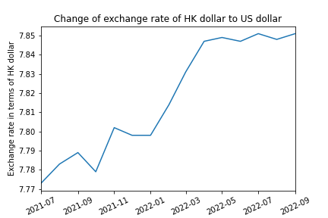
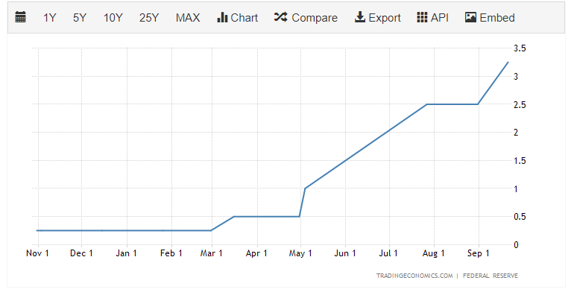
USD/HKD Exchange Rate vs USD Fed Interest Rate
The USD Fed Interest Rate chart:
https://tradingeconomics.com/united-states/interest-rate
Findings: USD getting stronger due to Fed raise interest rate

Slide 7
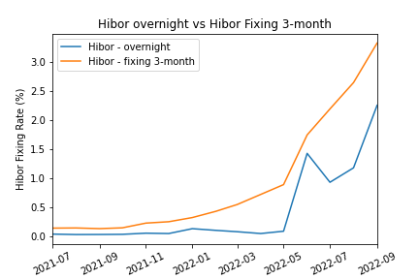
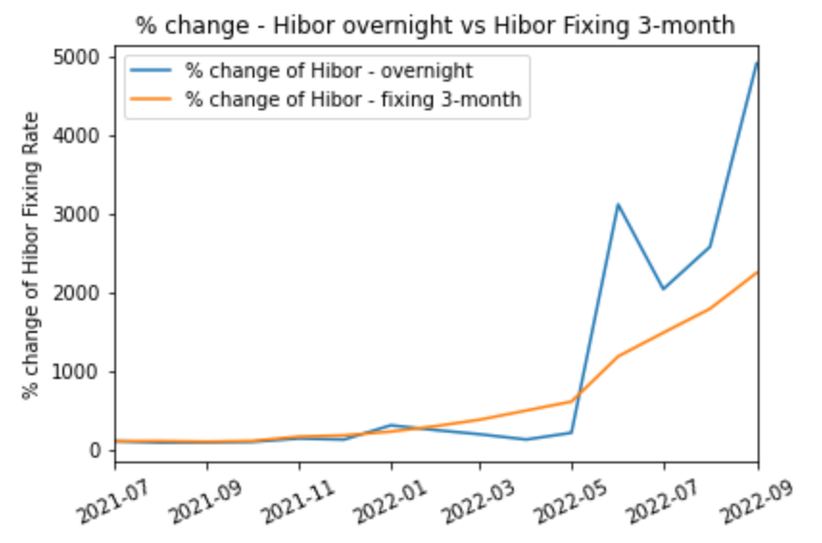
How is the Exchange Rate Affecting HIBOR?
Since USD/HKD hit 7.85, the HIBOR rate rise immediately.
As at Sep 2022, the percentage change of overnight rate was 50 times more than July 2021
*HIBOR is the benchmark of HKD interest rate for lending between banks within the HK market

Slide 8
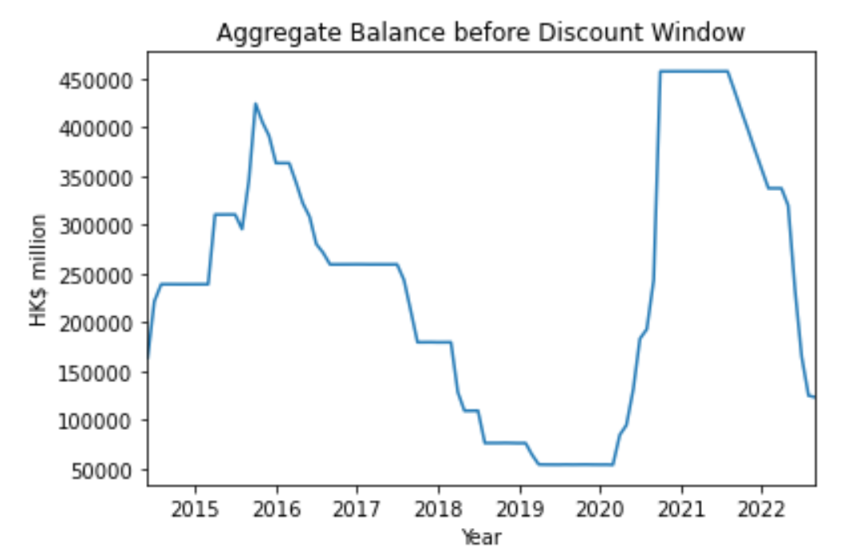
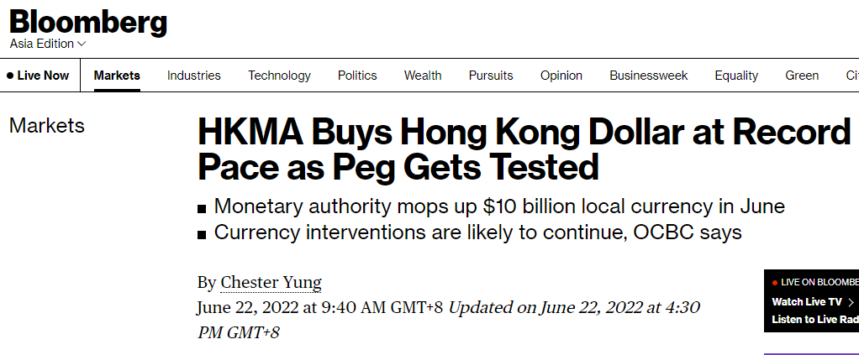
HKD Aggregate Balance Dropping as Exchange Rate Goes Up
Aggregate balance represents the level of interbank liquidity, and it is a part of monetary base

Slide 9



Challenges and Next Steps..
Next Steps
LImitations
Challenges
Enrich by collecting more data over time for more accurate analysis
Explore other factors that may affect the exchange rate, such as inflation, public debt, economic performance, etc.
Some datasets have limited time range (e.g: only past 180 days)
Different unit of measurements might be used in different data sets which makes comparison more difficult
Finding the suitable websites and datasets for extraction and analysis

Slide 10
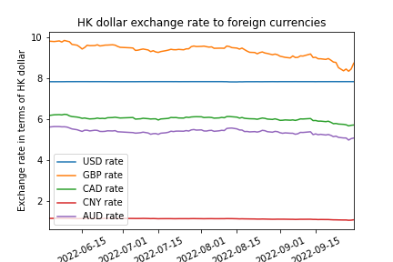
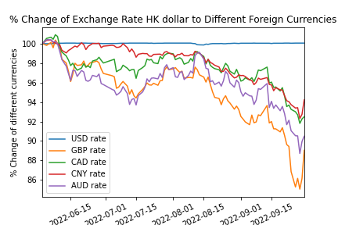
Conclusion
Peg Currency vs Non-peg Currency

Slide 11
THANKS! Q&A

